Slide 1

PROTOCOL
IN
POLITICS
(44 SLIDES)

Slide 2


Slide 3
PROTOCOL IN
POLITICS

Slide 4
PROTOCOL IN POLITICS
Material for this module
was taken from the NFRW
Protocol in Politics
the 1995 & 2003 editions, and the
U.S. Flag Code, 2006 revision.

Slide 5
PROTOCOL IN POLITICS
PROTOCOL:
Webster’s Dictionary describes protocol
as DIPLOMATIC ETIQUETTE.

Slide 6
PROTOCOL IN POLITICS
NFRW uses protocol as a code of political behavior that ensures proper conduct by using courtesy, consideration, respect, friendliness, and good manners.
Protocol covers meetings and events,
introductions, flag etiquette, and seating
arrangements, as well as the proper
way to address government officials and
distinguished guests.

Slide 7
PROTOCOL CHAIRMAN*
JOB DESCRIPTION:
Advises and assists the President in the proper conduct for meetings and events.
Assists with proper seating and introduction of head tables.
The Protocol Chairman only advises.
*The President may serve this role, or she may appoint a
Protocol Chairman.

Slide 8

MEETING PROTOCOL
BEFORE THE MEETING:
A. Determine your objectives for the meeting.
B. Prepare an agenda for the meeting.
C. Check minutes of the previous regular and board meetings
to find any unfinished business.
D. Contact officers and committee chairmen, as needed, to be
sure responsibilities have been fulfilled.
E. Arrive early at the meeting location to check arrangements.
Always check the PA system and any AV equipment before
starting the meeting.

Slide 9
MEETING PROTOCOL
BEGINNING THE MEETING:
A. Call the meeting to order ON TIME. (ONE rap of the gavel!)
B. Review and confirm objectives of the meeting.
C. Review action items from the previous meeting.

Slide 10
MEETING PROTOCOL
DURING THE MEETING:
A. Follow the agenda and guide the meeting in an
orderly and friendly manner. Timing and pacing
is the responsibility of the President.
B. Insist that all remarks be addressed to the Chair
to protect a speaker's right to the floor, and to keep
the meeting moving.
C. Keep the group focused.

Slide 11
MEETING PROTOCOL
DURING THE MEETING:
D. Retain control of the meeting at all times. Lack of control
is a discourtesy to members and to the people who follow
on the agenda.
E. Never "turn the meeting over" to anyone!
YOU ARE IN CHARGE.
F. Always introduce an officer or committee chairman to give
her report.
G. Be prepared to shift tactics if one is not working well.

Slide 12
MEETING PROTOCOL
ENDING THE MEETING:
A. Establish action items and responsibilities.
B. Sum up the meeting with a reminder of deadlines and
events.
C. Make any necessary announcements.
D. Thank those who participated in the program, and end the
meeting crisply and positively.
E. Adjourn the meeting ON TIME!

Slide 13
MEETING PROTOCOL
AFTER THE MEETING:
A. Put the room back in order.
B. Be prompt with follow up on action items after each
meeting.
C. Follow up with the Recording Secretary to prepare the
minutes of the meeting.

Slide 14
EVENT PROTOCOL
BEFORE THE EVENT:
A. Determine your objectives for the event.
B. Prepare a working agenda for event preparation.
C. Confirm the speaker for the event, and obtain information
for the introduction and publicity .
D. Contact the speaker with information regarding time
allocated for remarks, and share information regarding
other elected officials and/or honored guests.
E. Arrive early at the event location to check arrangements.
Always check the flags, PA system, and any AV equipment
before starting the event.

Slide 15
MEETING & EVENT
PROTOCOL REMINDERS
A. The Invocation always precedes the Pledge of Allegiance.
Remember: God Before Country.
B. When on a speakers platform, the American flag is always
to the speakers right as she faces the audience.
C. Assign a member to greet elected officials and honored
guests, and escort them into the venue.
D. Thank the speaker, elected officials and honored guests,
and be sure that they are escorted by a member as
they are exiting the event.
E. Always be gracious.

Slide 16
PROTOCOL FOR INTRODUCTIONS
Introductions may be made as the head table members enter the room, or after they are seated.
2. Head table introductions are always made beginning on the far left of the presiding officer, to the podium, then from the far right to the presiding officer, who introduces herself last.
Head table seating order will be illustrated later in the presentation.
4. When introducing candidates, the office held or the office aspired to will determine rank and order.

Slide 17
PROTOCOL FOR INTRODUCTIONS
5. At a campaign event, introduce family members of candidates, host committee, and senior members of the campaign staff.
6. Rank of elected officials determines the order of introductions, seating, and receiving lines.
7. Elected officials always take precedence over appointed officials.
8. The following slides indicate the order of rank for certain distinguished guests.

Slide 18
PROTOCOL IN POLITICS
RANKINGS OF ELECTED OFFICIALS AND
DISTINGUISHED GUESTS:
1. President of the United States
2. Vice President of the United States
3. Governor in his or her own state
4. Speaker of the U. S. House of Representatives

Slide 19
PROTOCOL IN POLITICS
RANKINGS OF ELECTED OFFICIALS AND
DISTINGUISHED GUESTS:
5. Chief Justice of the United States
6. Members of the President’s Cabinet
7. United States Senator
8. Governor of another state.

Slide 20
PROTOCOL IN POLITICS
RANKINGS OF ELECTED OFFICIALS AND
DISTINGUISHED GUESTS:
9. Member of the U. S. House of Representatives
10. Statewide Constitutional Officers
11. State Senators
12. State Representatives

Slide 21
PROTOCOL IN POLITICS
RANKINGS OF ELECTED OFFICIALS AND
DISTINGUISHED GUESTS:
13. Republican National Committee Members
14. State Party Leaders
15. Local Party Leaders
16. President or Chairman of Republican affiliate
organizations i.e. NFRW, Young Republicans,
College Republicans, etc.

Slide 22
FLAG ETIQUETTE
RESPECT FOR THE FLAG:
1. The flag should never be displayed with the
blue field down.
2. The flag should never touch anything beneath it.
3. The flag should always be carried aloft and free.
4. The flag should never be used as wearing
apparel, bedding, or drapery.

Slide 23
FLAG ETIQUETTE
RESPECT FOR THE FLAG:
5. When using bunting, it should be arranged with
the blue on top, white in the middle and red on
the bottom.
6. A lapel flag pin should be worn on the left lapel,
near the heart.
7. No other flag, banner or pennant should be
placed above, or if on the same level, to the
right of the flag of the United States.

Slide 24
FLAG ETIQUETTE
CONDUCT DURING THE PLAYING OF
THE NATIONAL ANTHEM:
When the national anthem is played, stand at attention facing the flag with right hand over heart. Men should remove hats and hold at left shoulder with hand over heart. Military personnel in uniform render the military hand salute. The 2006 revised U. S. Flag Code permits active duty and retired military personnel, not in uniform, to render the military hand salute. If the flag is not displayed, turn toward the music, and act in the same manner as though the flag was displayed.

Slide 25
FLAG ETIQUETTE
RECITING THE PLEDGE OF ALLEGIANCE:
When the Pledge of Allegiance is recited, stand at attention facing the flag with right hand over heart. Men should remove hats and hold at left shoulder with hand over heart. Military personnel in uniform render the military hand salute. The 2006 revised U. S. Flag Code permits active duty and retired military personnel, not in uniform, to render the military hand salute. If the flag is not displayed, turn toward the east, and act in the same manner as though the flag was displayed.

Slide 26
FLAG ETIQUETTE
WHEN THE FLAG PASSES IN REVIEW:
When the flag passes in review, stand at attention facing the flag, and follow the same courtesies as described in the previous slides for the National Anthem and the Pledge of Allegiance. Remain standing until the flag is retired, or has passed the immediate area.

Slide 27
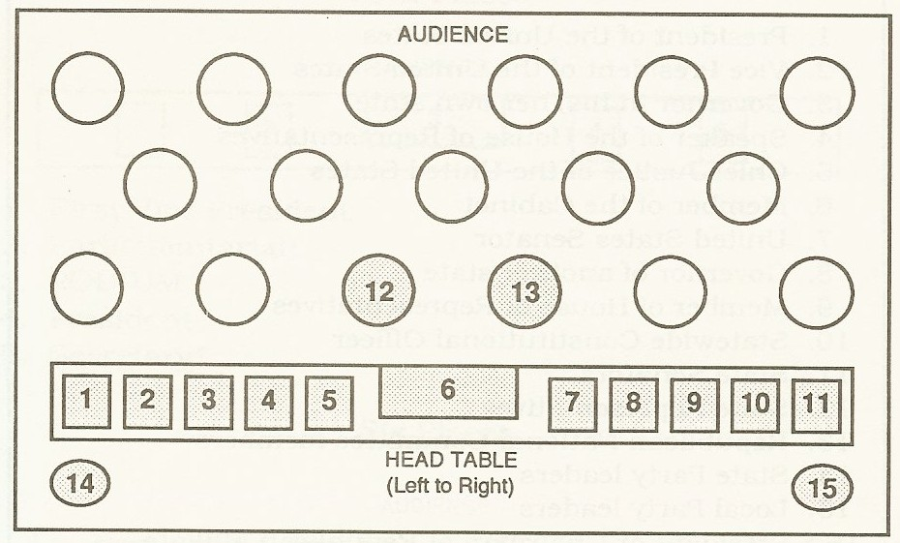
SEATING ARRANGEMENTS
HEAD TABLE SEATING FOR A BANQUET
Person Giving Invocation 8. Speaker / Special Guest
Fifth Ranking Official 9. Person Introducing Speaker
Third Ranking Official 10. Fourth Ranking Official
Honored Guest 11. Person Leading Pledge of Allegiance
Second Ranking Official 12. Other Elected Officials / Special Guests
PODIUM 13. Other Elected Officials / Special Guests
President 14. State Flag
15. United States Flag

Slide 28
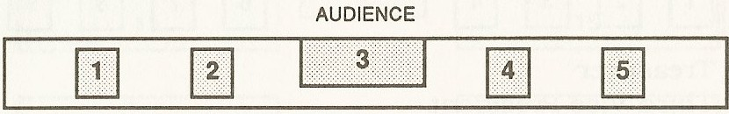
SEATING ARRANGEMENTS
FOUR PLACE HEAD TABLE SEATING
FOR BUSINESS MEETINGS:
  Secretary 3. PODIUM 4. President
  First Vice President 5. Parliamentarian

Slide 29
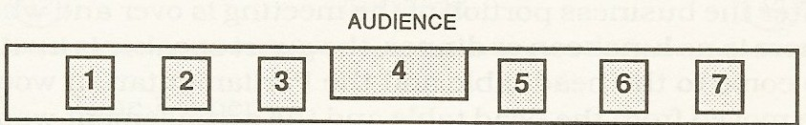
SEATING ARRANGEMENTS
SIX PLACE HEAD TABLE SEATING
FOR BUSINESS MEETINGS:
Treasurer 4.PODIUM 5. President
Second Vice President 6. Parliamentarian
First Vice President 7. Secretary

Slide 30
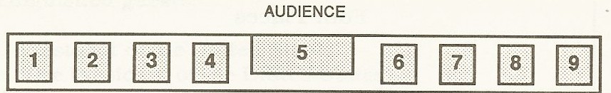
SEATING ARRANGEMENTS
EIGHT PLACE HEAD TABLE SEATING
BUSINESS MEETING:
Treasurer 5. PODIUM 6. President
Third Vice President 7. Parliamentarian
Second Vice President 8. Secretary
First Vice President 9. Fourth Vice President

Slide 31
SEATING ARRANGEMENTS
EIGHT PLACE HEAD TABLE SEATING
SOCIAL MEETING WITH SPEAKER:
Treasurer 5. PODIUM 6. President
Fourth Vice President 7. Guest Speaker
Second Vice President 8. Third Vice President*
First Vice President 9. Secretary
*Should exchange with the Vice President introducing the speaker.

Slide 32
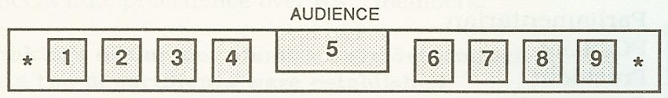
SEATING ARRANGEMENTS
TEN PLACE HEAD TABLE SEATING
FOR BUSINESS MEETING:
* Invocation 5.PODIUM 6. President
Treasurer 7. Parliamentarian
Third Vice President 8. Secretary
Second Vice President 9. Fourth Vice President
First Vice President * Pledge of Allegiance

Slide 33
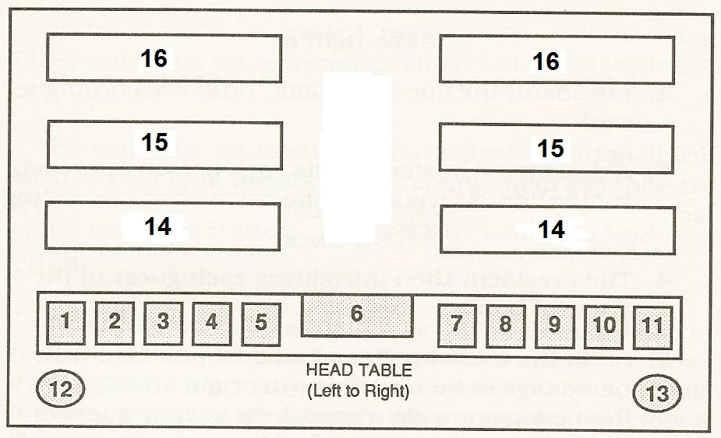
SEATING ARRANGEMENTS
HEAD TABLE SEATING FOR
BOARD / CONVENTION MEETINGS:
1. Invocation 7. President 12. State Flag
2. Treasurer 8. Parliamentarian 13. United States Flag
3. Third Vice President 9. Secretary 14. Voting Members
4. Second Vice President 10. Fourth Vice President 15. Non-voting Members
5. First Vice President 11. Pledge of Allegiance 16. Guests
6. PODIUM

Slide 34
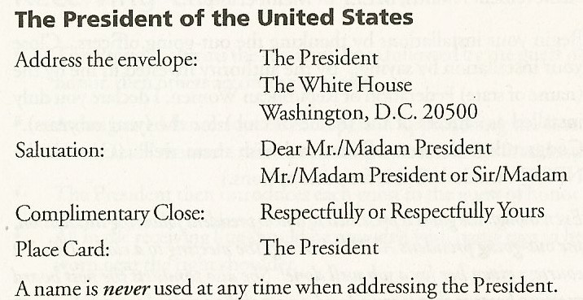
PROTOCOL IN POLITICS
COMMUNICATING WITH ELECTED OFFICIALS:

Slide 35
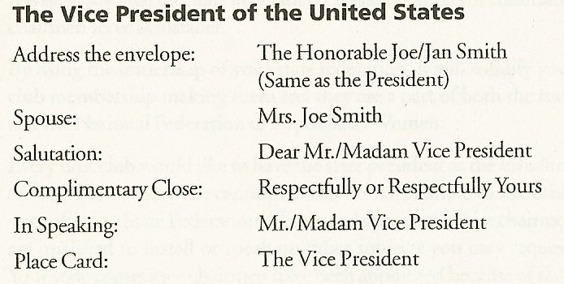
PROTOCOL IN POLITICS
COMMUNICATING WITH ELECTED OFFICIALS:

Slide 36
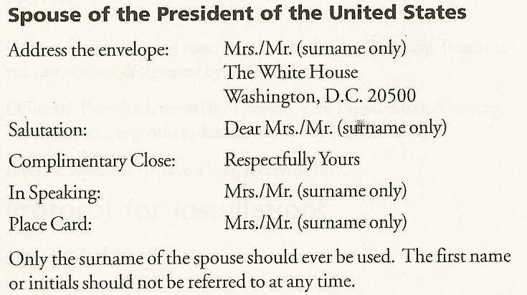
PROTOCOL IN POLITICS
COMMUNICATING WITH ELECTED OFFICIALS:

Slide 37
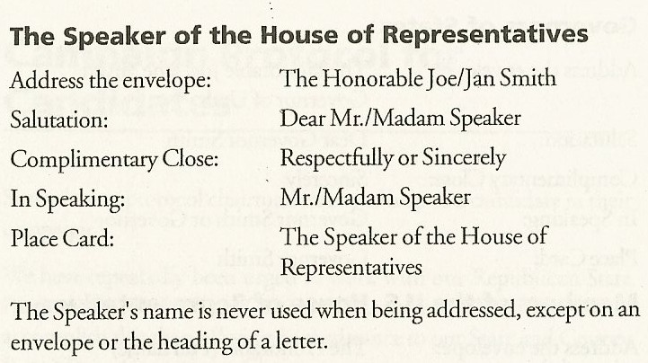
PROTOCOL IN POLITICS
COMMUNICATING WITH ELECTED OFFICIALS:

Slide 38
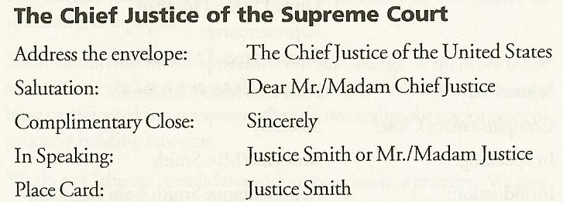
PROTOCOL IN POLITICS
COMMUNICATING WITH ELECTED OFFICIALS:

Slide 39
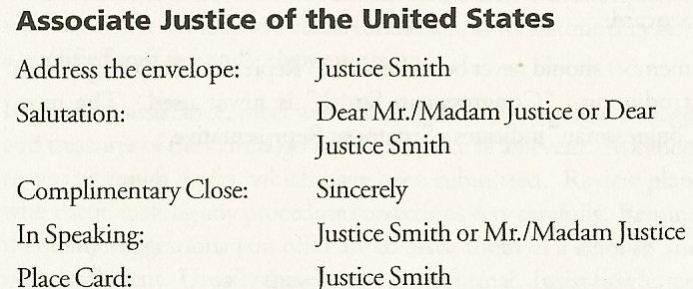
PROTOCOL IN POLITICS
COMMUNICATING WITH ELECTED OFFICIALS:

Slide 40
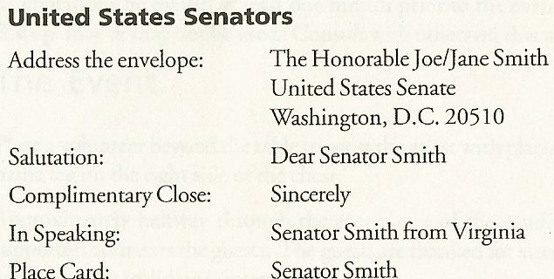
PROTOCOL IN POLITICS
COMMUNICATING WITH ELECTED OFFICIALS:

Slide 41
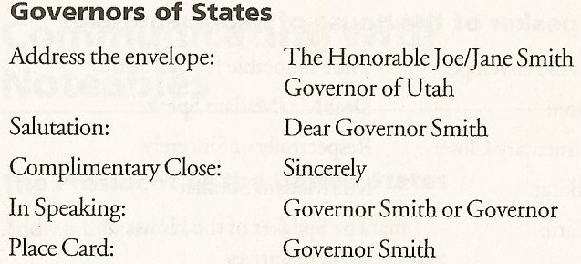
PROTOCOL IN POLITICS
COMMUNICATING WITH ELECTED OFFICIALS:

Slide 42
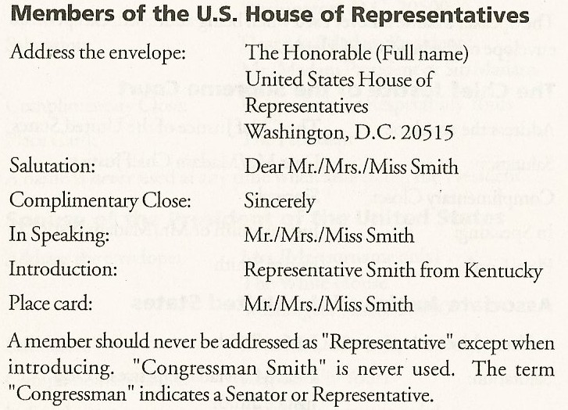
PROTOCOL IN POLITICS
COMMUNICATING WITH ELECTED OFFICIALS:

Slide 43
SUMMARY
NFRW uses protocol as a code of political behavior that ensures proper conduct by using courtesy, consideration, respect, friendliness, and good manners.
Protocol covers meetings and events,
introductions, flag etiquette, and seating
arrangements, as well as the proper
way to address government officials and
distinguished guests.

Slide 44
SUMMARY
When NFRW, State Federations, and local Clubs demonstrate the proper use of protocol, it will ensure that meetings and events are conducted with respect to all who attend. The use of proper flag etiquette and seating arrangements, as well as the proper address of government officials and distinguished guests illustrates utmost professionalism.

